Slide 1
CLASS PROBABILITIES

Slide 2
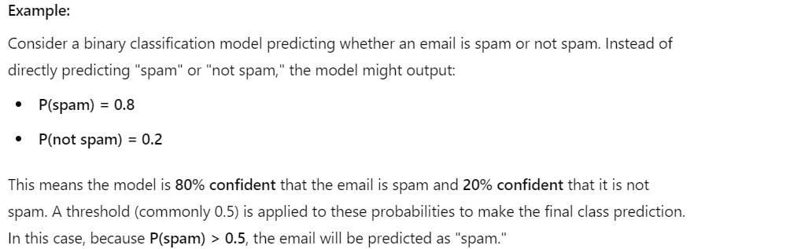
Class probabilities represent the likelihood that an instance belongs to each class.
Instead of directly giving a class label, the model outputs a probability score between 0 and 1 for each class.
These probabilities indicate the model's confidence in its predictions.

Slide 3
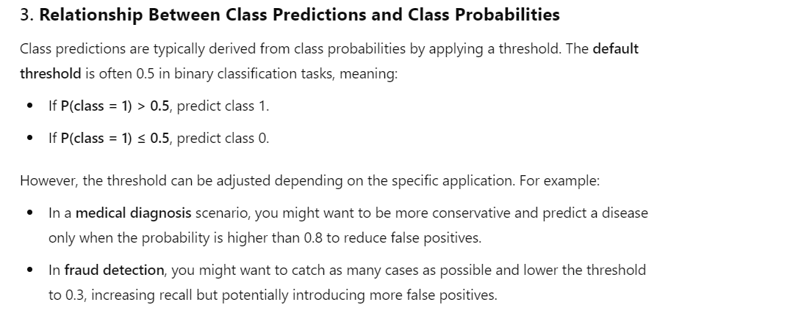

Slide 4
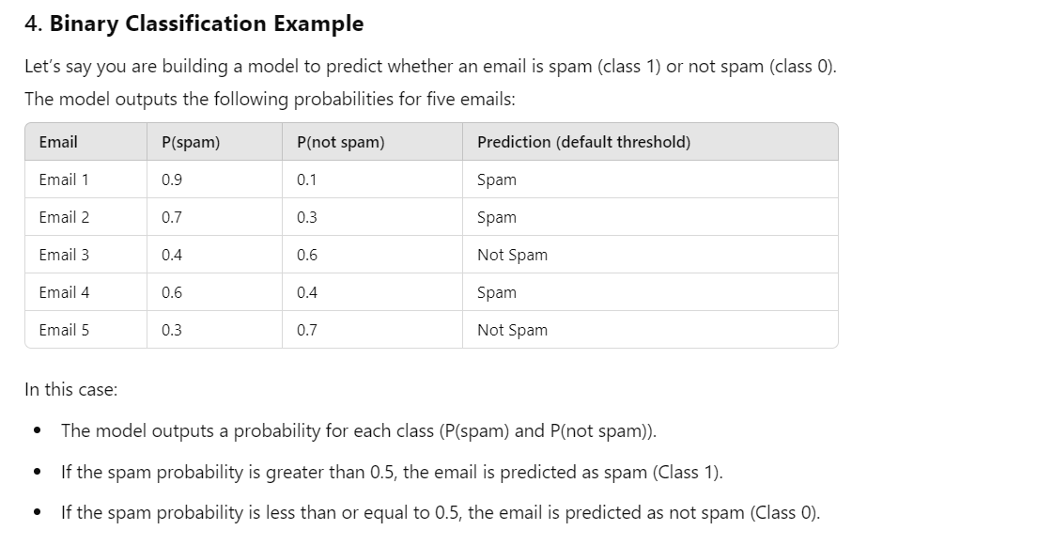

Slide 5
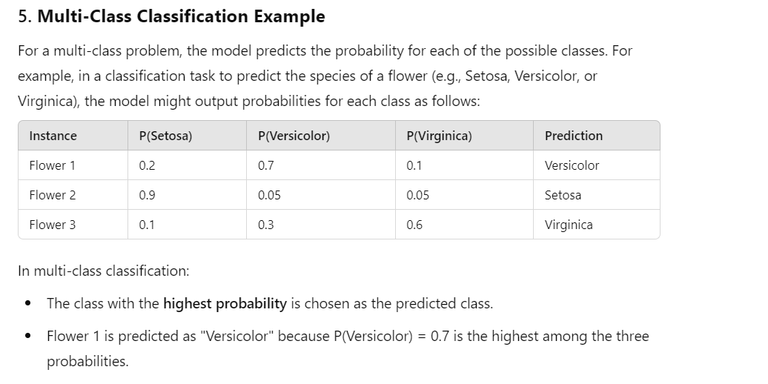

Slide 6
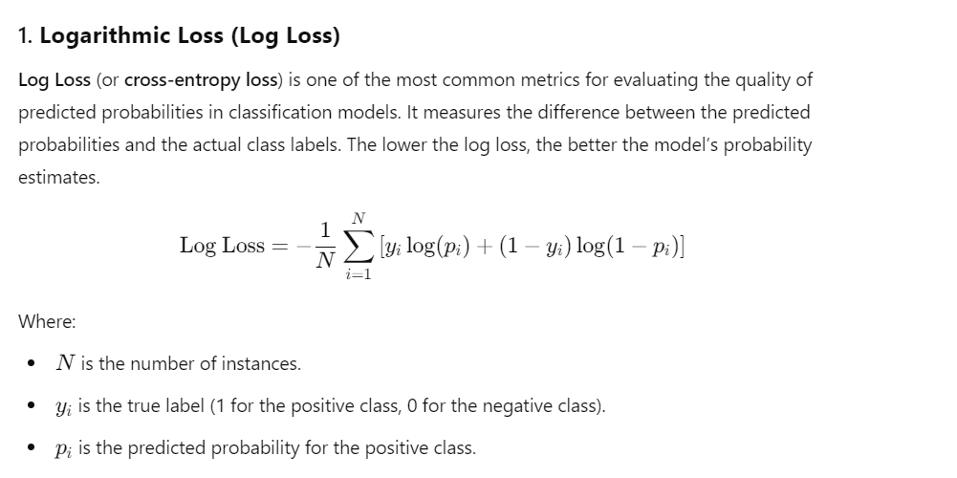
EVALUATING CLASS PROBABILITIES

Slide 7
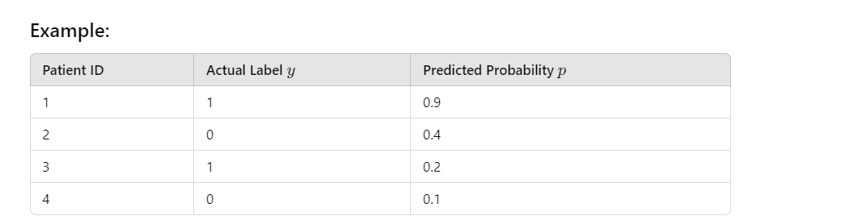
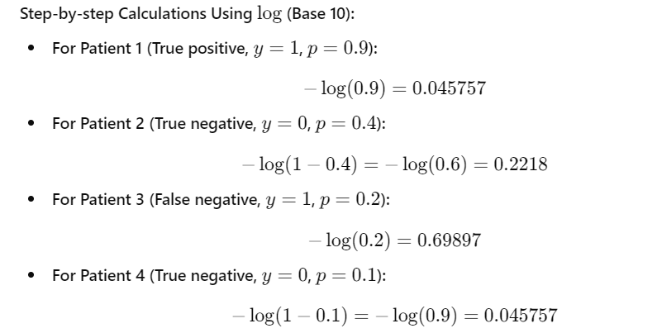

Slide 8
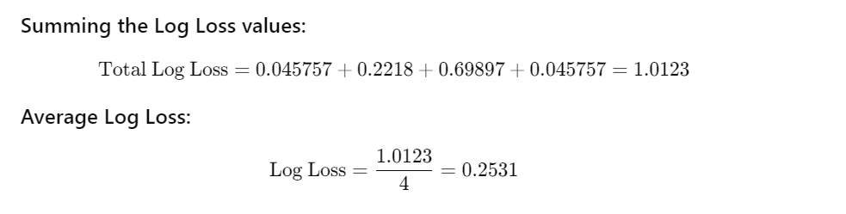

Slide 9
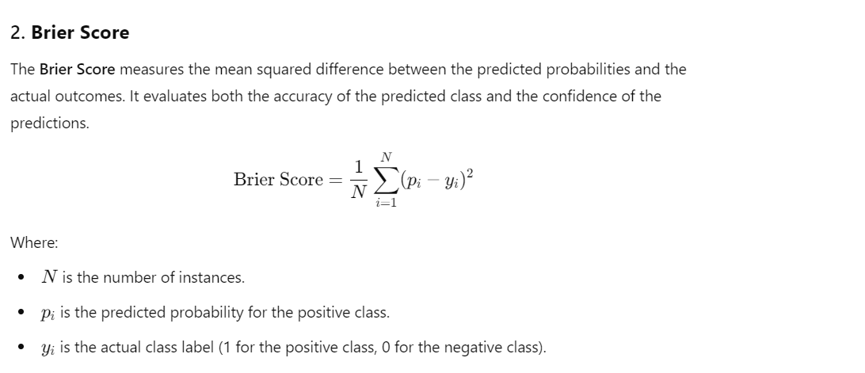

Slide 10
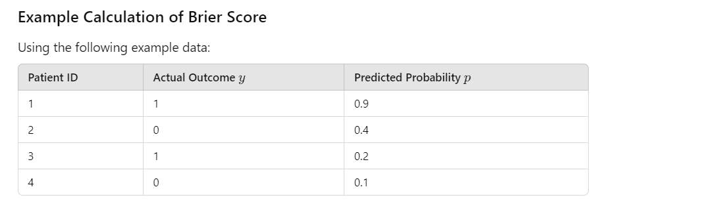
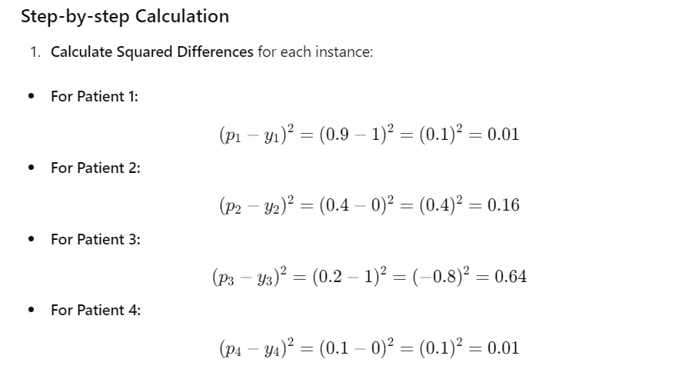

Slide 11


Slide 12
